Slide 1
أكـــــاديميــــة طــــويـــق
Deep Learning

Slide 2
Image Processing Basics for Deep Learning
By: Dr. Afshan Hashmi

Slide 3
Course Objectives:
Explain digital image representation as numerical pixel arrays.
Differentiate between RGB and grayscale image formats.
Resize images to standard dimensions for model input.
Normalize pixel values to improve model training.
Convert images between color spaces (RGB, grayscale).
Implement data augmentation to expand training datasets.
Load and preprocess images from local and web sources.
Visualize image transformations using Python libraries.
Process CIFAR-10 dataset for machine learning applications.

Slide 4
Understanding Images as Data
What is an Image?
An image is a grid of pixels (picture elements).
Each pixel represents a color intensity value.
Pixels: The Building Blocks of Images
What is a pixel? A pixel (short for picture element) is the smallest unit of an image. Think of it as a tiny square that holds a color or brightness value.
How do pixels form an image? Images are made by arranging pixels in a grid (rows × columns). The higher the number of pixels, the more detailed (higher resolution) the image.
Grayscale Images (1 Channel)
Each pixel holds one value representing intensity or brightness.
Intensity ranges from 0 to 255:
0 = black
255 = white
Values in between represent shades of gray.

Slide 5
Understanding Images as Data
Example: A 28×28 grayscale image (like in MNIST dataset) has 28×28 = 784 pixel values.
RGB Images (3 Channels)
Each pixel has three values, one for each color channel:
R (Red)
G (Green)
B (Blue)
Each value ranges from 0 to 255.
The combination of these three determines the final color of the pixel.
Example: An RGB image of 100×100 size will have 100×100×3 = 30,000 values.
Think of it this way:
Grayscale = 2D matrix (Height × Width)
RGB = 3D matrix (Height × Width × 3)

Slide 6
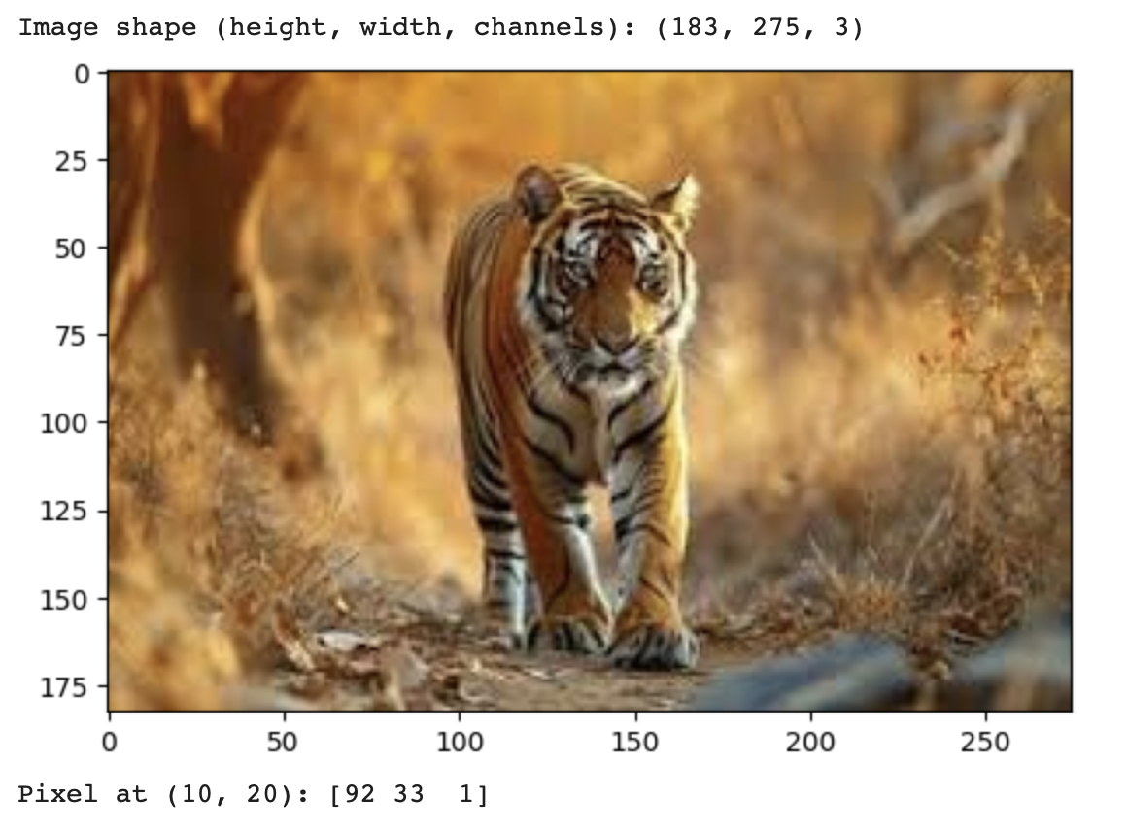
Viewing Pixel Values in an Image
When working with images in computer vision or machine learning, it's important to understand how to view and interpret pixel values.
# Load an image
image = cv2.imread("/content/tiger.jpeg") # BGR format (OpenCV default)
print("Image shape (height, width, channels):", image.shape)
# Convert BGR to RGB (Matplotlib uses RGB)
image_rgb = cv2.cvtColor(image, cv2.COLOR_BGR2RGB)
# Display the image
import matplotlib.pyplot as plt
plt.imshow(image_rgb)
plt.show()
# Print pixel values at (y=10, x=20)
print("Pixel at (10, 20):", image_rgb[10, 20])

Slide 7
Splitting Channels in an RGB Image
"Splitting channels" means separating an image into its individual color components Red, Green, and Blue which are stored in separate matrices (2D arrays).
Why Split Channels?
To analyze or process individual color components.
Useful in computer vision tasks like feature extraction, filtering, or enhancement.
Each channel shows how much of that color is present in each pixel.
Example: RGB Image
An RGB image is a 3D array of shape (Height, Width, 3):
Red channel → image[:, :, 0]
Green channel → image[:, :, 1]
Blue channel → image[:, :, 2]

Slide 8
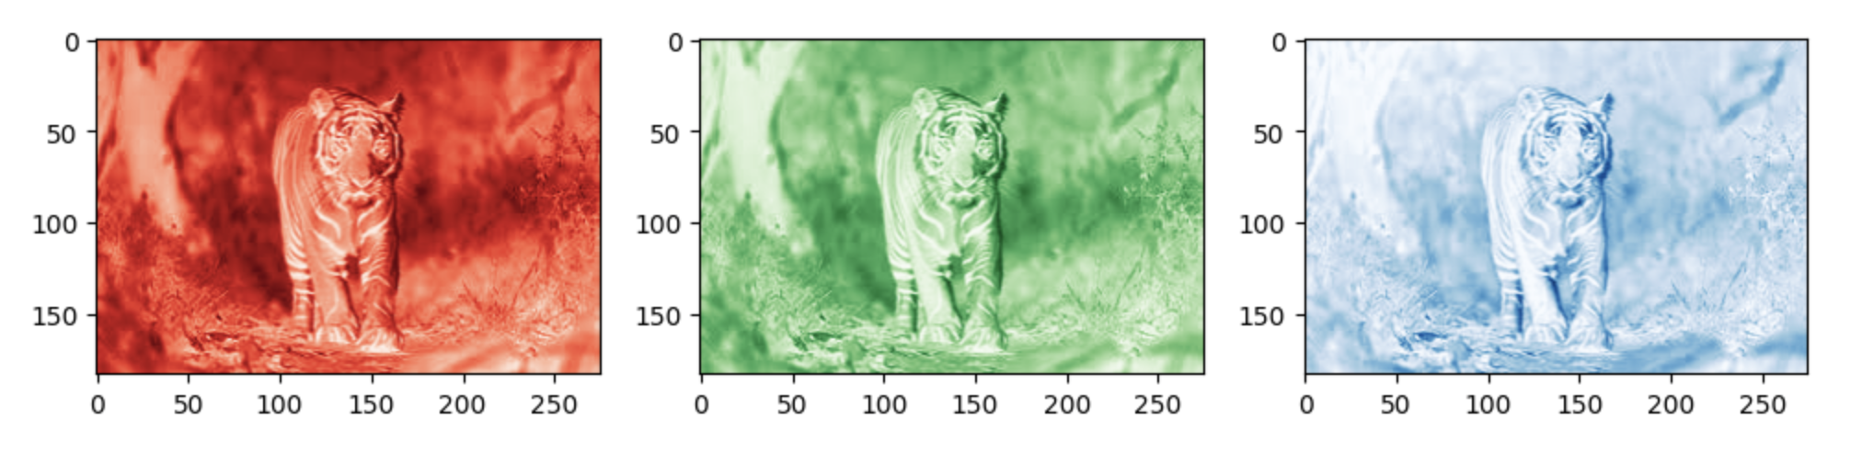
Splitting Channels in an RGB Image
# Split into R, G, B channels
r, g, b = cv2.split(image_rgb)
# Plot each channel
fig, axes = plt.subplots(1, 3, figsize=(12, 4))
axes[0].imshow(r, cmap='Reds')
axes[1].imshow(g, cmap='Greens')
axes[2].imshow(b, cmap='Blues')
plt.show()

Slide 9
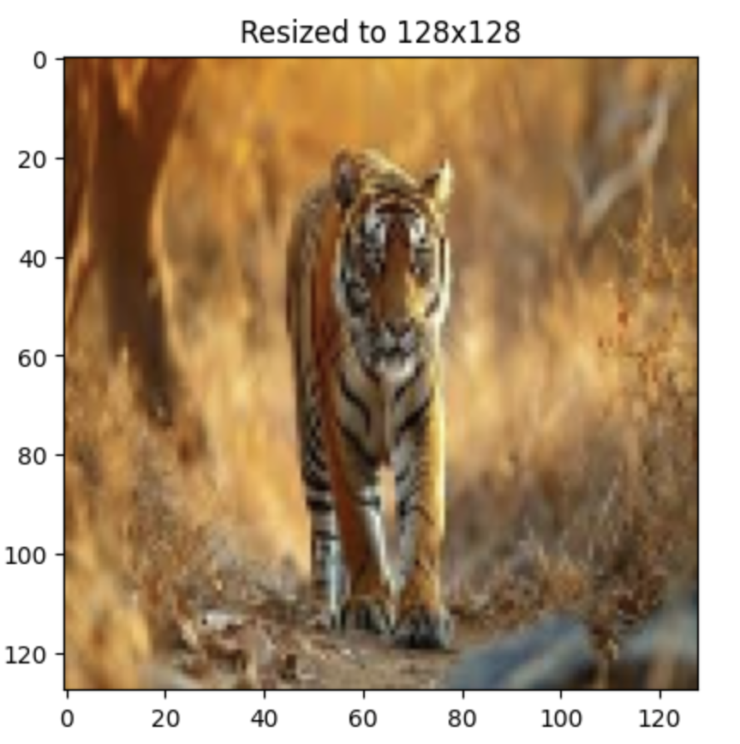
Image Transformations
These transformations help standardize images and prepare them for machine learning
models (especially deep learning models).
Rescaling (Resizing)
Why?
Neural networks require input images to be the same size. Resizing ensures all images are uniform (e.g., 128×128 pixels).
How?
Use libraries like OpenCV to resize images.
resized = cv2.resize(image_rgb, (128, 128))
plt.imshow(resized)
plt.title("Resized to 128x128")
plt.show()

Slide 10
Normalization
Image normalization is a typical process in image processing that changes the range of pixel
intensity values. Its normal purpose is to convert an input image into a range of pixel values that
are more familiar or normal to the senses, hence the term normalization.
In this work, we will perform a function that produces a normalization of an input image
(grayscale or RGB). Then, we understand a representation of the range of values of the scale of
the image represented between 0 and 255, in this way we get, for example, that very dark
images become clearer. The linear normalization of a digital image is performed according to
the formula
Output channel = 255 * (Input channel - min) / (max-min)
If we are using a grayscale image, we only need to normalize using one channel. However, if we
are normalizing a RGB (3 channels) we need to normalize for each channel using the same
criteria.
Why ? Pixel values in raw images range from 0 to 255. Neural networks work better when values are scaled down to a smaller, consistent range such as [0, 1] or [-1, 1].
How? Divide by 255 to convert values from [0, 255] → [0.0, 1.0].
normalized = image_rgb / 255.0 # [0, 1] range
print("Min:", normalized.min(), "Max:", normalized.max())

Slide 11
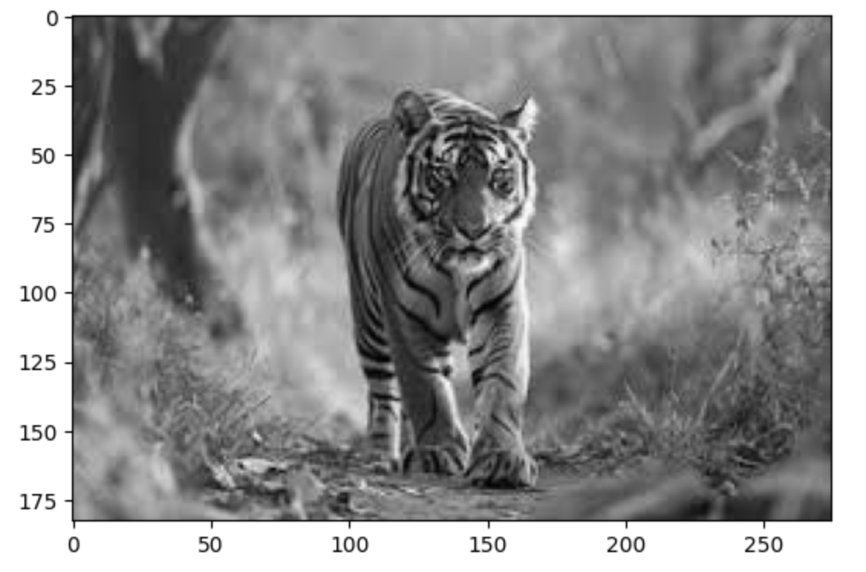
Grayscale Conversion
Why? Grayscale images require less memory and are often enough for many tasks (e.g., handwritten digit recognition).
Converts 3 color channels (RGB) into 1 intensity channel.
How? Use OpenCV or similar libraries to convert to grayscale.
gray = cv2.cvtColor(image_rgb, cv2.COLOR_RGB2GRAY)
plt.imshow(gray, cmap='gray')
plt.show()

Slide 12
Image Transformation Summary:
Transformation | Purpose | Benefit
Rescaling | Resize image dimensions | Uniform input size for models
Normalization | Scale pixel values | Stable, faster model training
Grayscale Conversion | Reduce to 1 channel (from 3) | Saves memory, faster computation

Slide 13
Image Augmentation
Image Augmentation is a data augmentation method that generates more training data from the existing training samples. Image Augmentation is especially useful in domains where training data is limited or expensive to obtain like in biomedical applications.
It is basically Artificially expanding dataset by applying random transformations.
Why Use Augmentation?
Improves generalization
Increases dataset diversity
Common techniques: rotation, flipping, zooming, shifting

Slide 14
Reasons to Use Augmentation
1. Improves Generalization
Helps models learn more robust features.
Reduces overfitting by exposing the model to more variation during training.
Without augmentation, a model might memorize training images instead of learning meaningful patterns.
2. Increases Dataset Diversity
Makes a small dataset behave like a larger one.
Simulates real-world variations (like different angles, lighting, positions).
Especially useful when collecting more data is expensive or impractical.
Common Augmentation Techniques:
Technique | What it does | Example Usage
Rotation | Rotates image by random angle | Makes model invariant to orientation
Flipping | Horizontally or vertically flips | Simulates mirror views
Zooming | Zooms into image | Handles scale variations
Shifting | Moves image up/down/left/right | Tolerates object positioning changes

Slide 15
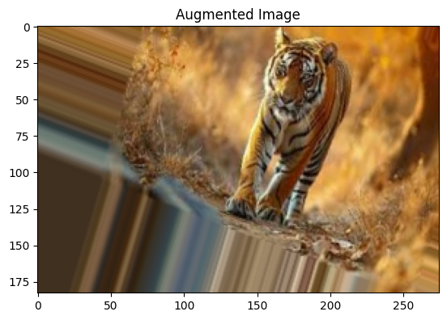
Augmentation with Keras
from tensorflow.keras.preprocessing.image import ImageDataGenerator
datagen = ImageDataGenerator(
rotation_range=20,
width_shift_range=0.1,
height_shift_range=0.1,
horizontal_flip=True,
zoom_range=0.2
)
# Apply to a single image (expand dims to simulate batch)
augmented = datagen.flow(np.expand_dims(image_rgb, 0))
plt.imshow(augmented[0][0].astype('uint8'))
plt.title("Augmented Image")
plt.show()

Slide 16
Preprocess CIFAR-10 Images
Load CIFAR-10 dataset.
Convert a sample image to grayscale.
Normalize pixel values.
Apply augmentation (rotation + flip).
from tensorflow.keras.datasets import cifar10
# Load data
(x_train, y_train), (_, _) = cifar10.load_data()
sample_image = x_train[0] # RGB image
# Grayscale conversion
gray_sample = cv2.cvtColor(sample_image, cv2.COLOR_RGB2GRAY)
# Normalization
normalized_sample = gray_sample / 255.0
# Augmentation
datagen = ImageDataGenerator(rotation_range=20, horizontal_flip=True)
augmented = datagen.flow(np.expand_dims(sample_image, 0))
# Plot results
fig, axes = plt.subplots(1, 3, figsize=(12, 4))
axes[0].imshow(sample_image)
axes[1].imshow(gray_sample, cmap='gray')
axes[2].imshow(augmented[0][0].astype('uint8'))
axes[0].set_title("Original")
axes[1].set_title("Grayscale")
axes[2].set_title("Augmented")
plt.show()

Slide 17

Summary
Concept | Key Points | Code Snippet
Pixels | Grid of values (0-255) | image.shape, image[y, x]
Channels | RGB (3), Grayscale (1) | cv2.cvtColor(image, COLOR_RGB2GRAY)
Rescaling | Resize for consistency | cv2.resize(image, (new_w, new_h))
Normalization | Scale to [0, 1] | image / 255.0
Augmentation | Generate synthetic data | ImageDataGenerator(...)

Slide 18
Books and References
"Deep Learning" (Ian Goodfellow et al.)
"Neural Networks and Deep Learning" (Michael Nielsen)
Courses
Deep Learning Specialization (Andrew Ng, Coursera)
Fast.ai Practical Deep Learning
Datasets for Practice
MNIST (Handwritten digits)
CIFAR-10 (Image classification)
IMDB Reviews (Sentiment analysis)

Slide 19
Practice with Google COLAB
Click here https://drive.google.com/file/d/1F7hVj1kMKkuVm76PUUTAoLFtzY1ZGVPT/view?usp=share_link

Slide 20
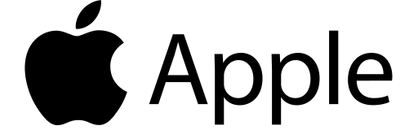
















الشراكات العالمية

Slide 21
شــــــكــــرًا لكــــــم
THANK YOU

